Slide 1

SNS
Social Network using SOLID
New Generation Web
“You affect the world by what you browse”
Notes:
To use this title animation slide with a new image simply 1) move the top semi-transparent shape to the side, 2) delete placeholder image,
3) click on the picture icon to add a new picture, 4) Move semi-transparent shape back to original position, 5) Update text on slide.

Slide 2
Group
Members
Zeeshan Akbar F161BSCS013
Aniqa Sadaf F161BSCS021
M. Usama Mobeen F161BSCS031
Zahra Nadeem F161BSCS048
Dr. Shariq Husssain (HOD SE FURC)
Mr. Umar Mahmood (Assistant Professor)
Foundation University Rawalpindi

Slide 3
Problem Statement
Privacy of personal data is a challenging problem for the Computer Scientist / Web Security Consultant since the birth of World Wide Web.
The data of an individual is either stored on a data center or website’s servers.
Ownership of Online Data
On joining, the companies can use that data for advertisements or can sell it without the permission of the user who is the owner of that data.

Slide 4
Example
Facebook
“Data Collection”
  Facebook Artificial Intelligence Algorithms are continuously collecting data of individuals and selling it to advertisement companies to survive in the industry.
“Content Sharing”
  On lower level users can share their friend’s posts or use it in some illegal work.
“Data Ownership”
  User has partial control on shared data

Slide 5
Proposed Solution
Solid is an exciting new project led by Prof. Tim Berners-Lee, inventor of the World Wide Web, taking place at MIT.
User can apply permission to the shared content.
SOLID Architecture
The project aims to radically change the way Web applications work today, resulting in true data ownership as well as improved privacy.

Slide 6
SOLID
Socially Linked Data
1
2
3
True data ownership
Modular design
Reusing existing data

Slide 7
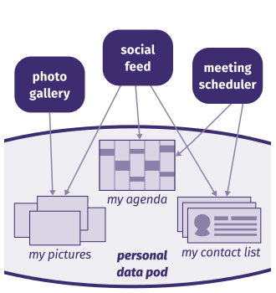
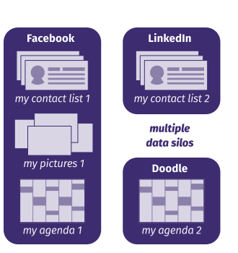
Comparison
!
SOLID based Web Applications
Other Web Applications
LINKED IN SERVER
FACEBOOK SERVER
DOODLE
SERVER

Slide 8
Our Solution
Web Based Social Network using SOLID

Slide 9
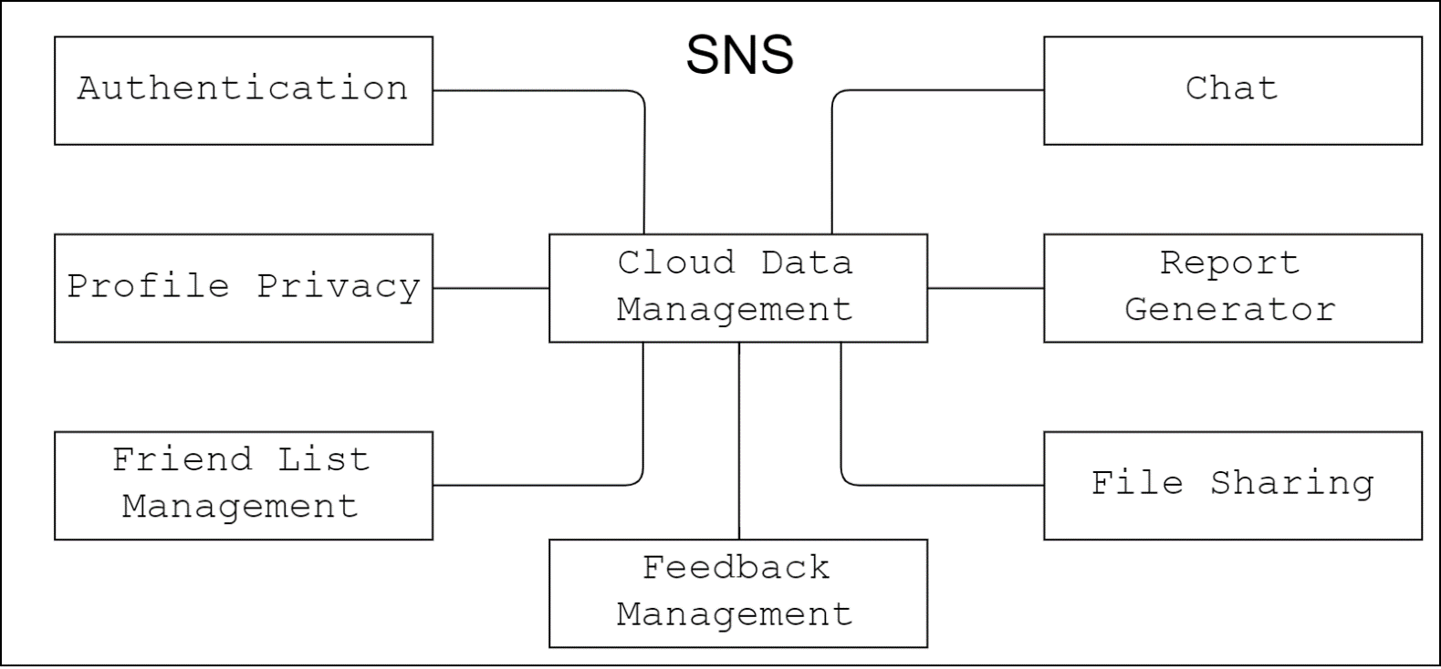
Block Diagram

Slide 10
Requirements

Slide 11
Features
Sr. No | Feature | Description
F001 | Authentication | POD’s web_id, username and password are asked through login page. Signup through sign up page which ask user basic information i.e. email, username, password etc.
F002 | Chat | Content shared to friends or groups in the form of messages. User can share messages separately as well as in groups.
F003 | Profile Privacy | Profile privacy access given to user. Permissions like (who can view, send friend request, share, post any content)
F004 | File Sharing | Files/pictures can be shared through chat as well as on profile.

Slide 12
Features
Sr. No | Feature | Description
F005 | Friend List Management | The user can manage who can be in his friend list and in which category.
F006 | Cloud Data Management | Data of the user is stored on cloud storage (POD) and managed by user itself through a dashboard page provided.
F007 | Feedback Management | The user can give feedback or report a complain/problem from the SNS using a provided feedback form.
F008 | Report Generator | Admin can request report for the usage of SNS on basis on date and can download that report in pdf form using the provided data analysis form.

Slide 13
Functional Requirements
Feature No. | Feature | Sr. no | Functional Requirement | Description
F001 | AUTHENTICATION | FR001 | Signup | A register form containing text fields Text field of type email will be provided for the user to enter its valid email address. The number of max-characters shall be 100. 80 columns (characters) will be visible further horizontal scrolling is turned on.
 |  |  |  | Password shall be provided by the user in password text field. The password will be alphanumeric having maximum character limit of 50. The password characters will be hidden and shown as steric.
 |  |  |  | Get Username and Name in text field of type text. There is register button that performs registration of user for POD and redirects to LOGIN page for authentication.

Slide 14
Functional Requirements
Feature No. | Feature | Sr. no | Functional Requirement | Description
F001 | AUTHENTICATION | FR002 | Login | A popup window will open which have text fields for username, web ID and password. User will type username in text field of type text.(Alphanumeric)
 |  |  |  | User will enter POD's password in a text field of type password. A login button will perform authentication for POD to login to SNS.
 |  |  |  | On wrong credentials the text fields will be cleared automatically.
 |  |  |  | After authentication the user will be redirected to the newsfeed page.

Slide 15
Functional Requirements
Feature No. | Feature | Sr. no | Functional Requirement | Description
F002 | CHAT | FR003 | Individual Chat Group Chat | 'New Message’ button will be provided, on clicking user will be asked for the participants using a dropdown list and checkpoint selection. At this time User will be able toggle between Individual / Group chat. This container will contain a button for sending messages.
 |  | FR004
 |  |  |  | A text area will be provided to the user in which he will be able to enter the message.
 |  |  |  | There will be a button for file sharing or any attachment in the message.

Slide 16
Functional Requirements
Feature No. | Feature | Sr. no | Functional Requirement | Description
F002 | CHAT | FR005 | Chat Restrictions | A dialog box for containing checkpoints and labels showing permissions for the file shared shall be provided..
 |  |  |  | Button of cancel and apply, that will cancel the dialog box or apply selected permissions respectively.
F003 | PROFILE PRIVACY | FR006 | Content Privacy | To apply permission a dialog box for what content can be viewed which contains permissions followed by checkpoints or toggle buttons (on/off) will be added.
 |  |  |  | A cancel button to revert changes and apply button to apply selected permissions shall be provided.
 |  | FR007 | Access Control | To apply permission a dialog box for what content can be viewed which contains permissions followed by checkpoints or toggle buttons (on/off) will be added.

Slide 17
Functional Requirements
Feature No. | Feature | Sr. no | Functional Requirement | Description
F003 | PROFILE PRIVACY | FR007 | Access Control | A cancel button to revert changes and apply button to apply selected permissions shall be provided.
 |  | FR008 | Public Profile | To apply permission a dialog box for what content can be viewed which contains permissions followed by checkpoints or toggle buttons (on/off) will be added.
 |  |  |  | A cancel button for revert changes and apply button to apply selected permissions.
F004 | CLOUD DATA MANAGEMENT | FR009 | Personal Data Management | Sections public, private and inbox will be provided.
 |  |  |  | Button for delete POD, logout, Login and register will be given.

Slide 18
Functional Requirements
Feature No. | Feature | Sr. no | Functional Requirement | Description
F004 | CLOUD DATA MANAGEMENT | FR010 | Access Management | A dashboard is provided having admin panel characteristics through which user can change access to the file present on POD.
 |  |  |  | There are sections public, private and inbox.
 |  |  |  | There will be buttons for delete POD, logout, login, register.
F005 | FILE SHARING | FR011 | Upload File | Button to select files through a file browser and an upload button will be provided.
 |  | FR012 | Download File | Files will be downloaded to a local directory though a download button provided. User will be able to select downloading directory using a file browser.

Slide 19
Functional Requirements
Feature No. | Feature | Sr. no | Functional Requirement | Description
F006 | FRIEND LIST MANAGEMENT | FR013 | Add Friend | Text field will be provided for the user to enter the web ID or profile URL to add Friend.
 |  |  |  | A button is provided right next to text field that performs search the profile and add friend. If nothing found user will be notified by an error message.
 |  | FR014 | Un Friend | Friend's profile URL and web ID will be shown in a table.
 |  |  |  | The table will contain action button 'remove' for each profile. Remove button will perform Unfriending of that profile from friend list.
 |  |  |  | 'categorize' button which will redirect the user to friends categories will be provided.

Slide 20
Functional Requirements
Feature No. | Feature | Sr. no | Functional Requirement | Description
F006 | FRIEND LIST MANAGEMENT | FR015 | Categorize Friends | Different tables for different categories showing profiles with action buttons 'remove' and 'change Category' will be shown. Change Category button will open a dialog box which will asks user to select category of the profile.
 |  |  |  | Remove button will remove that profile from friend list.
 |  |  |  | The dialog box will contain categories names with checkboxes. A cancel button and apply button. 'All Friends' button which will redirect the user to all friends page.

Slide 21
Functional Requirements
Feature No. | Feature | Sr. no | Functional Requirement | Description
F007 | FEEDBACK MANAGEMENT | FR016 | Feedback | A form is provided with text fields for email, name and message with a button to send the feedback.
 |  |  |  | Email text field check for valid email and maximum character count is 30.
 |  |  |  | The send button redirects the user to home page and send the feedback to admin.
F008 | REPORT GENERATOR | FR017 | View Report | A table is shown containing the analysis of data requested as a report. Having a download button at the top right.
 |  | FR018 | Download Report | Download button downloads the report in pdf. Download location is user-selected using file browser.

Slide 22
Non Functional Requirements
Sr. no | Non Functional Requirement |  | Description
NFR001 | Security | Confidentiality | Pod is used to achieve confidentiality in the form of access control list.
 |  | Availability | The product will be available 24/7 for this server Apache.
NFR002 | Portability |  | Size of product is less than 20 MB.
NFR003 | Usability |  | A new user can use the product with several minutes of training provided as tutorial video.
NFR004 | Reliability |  | Number of 2 crashes per user/day/month.
NFR005 | Responsiveness |  | The system will respond in under 5 seconds.
NFR006 | Accessibility |  | Blue text for username, gray text for shared content and black for others.
NFR007 | Development Environment |  | Windows 10, JavaScript, JQuery, ldflex.js, solid-file-client, solid-auth-client, XML, TURTLE, RDF.
NFR008 | Compatibility |  | Firefox 69.0.1 Chrome 61.0.3163

Slide 23
Constraints
Constraint s | Description
DC#1 | System will have static interface color scheme.
DC#2 | File size that can be uploaded should be less than 100 MB.
DC#3 | Internet should be provided for the application to run.
IC#1 | Online POD is used instead of local.
IC#2 | POD should be accessible by the user.

Slide 24
Bench Marking
Features Comparison

Slide 25
Benchmarking
Application | Authentication | Chat | Profile Privacy | File Sharing | Friend List Management | Cloud Data Management (True Ownership)
What’s App | ✔ | ✔ | ✔ | ✔ | ✔ | ✗
Facebook | ✔ | ✔ | ✔ | ✔ | ✔ | ✗
Tumblr | ✔ | ✔ | ✔ | ✔ | ✗ | ✗
Instagram | ✔ | ✔ | ✔ | ✔ | ✔ | ✗
YouTube | ✔ | ✗ | ✔ | ✔ | ✗ | ✗
SNS | ✔ | ✔ | ✔ | ✔ | ✔ | ✔

Slide 26
Design
Data Flow Diagrams

Slide 27
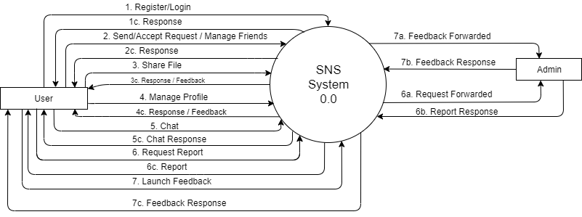
DFD Level 0

Slide 28
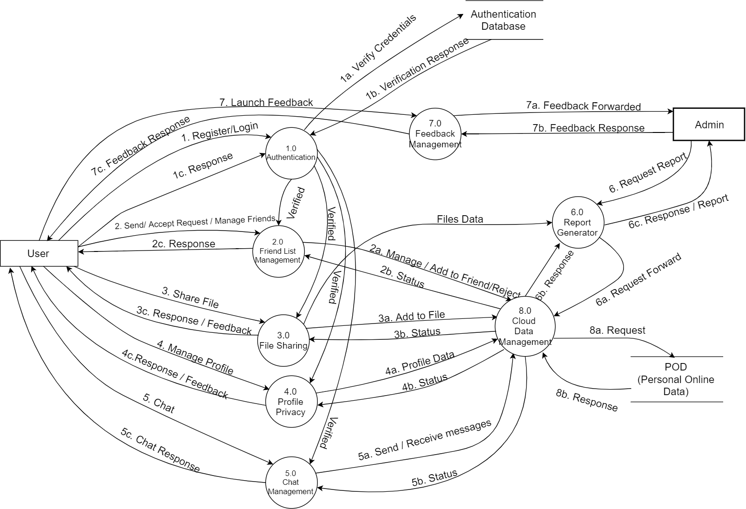
DFD Level 1

Slide 29
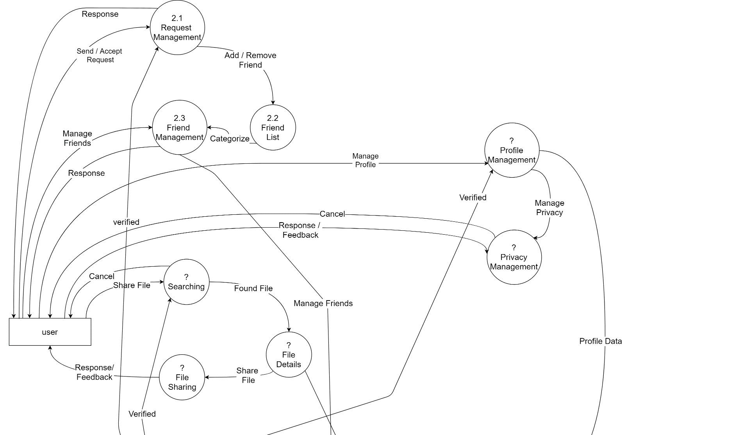
DFD Level 2

Slide 30
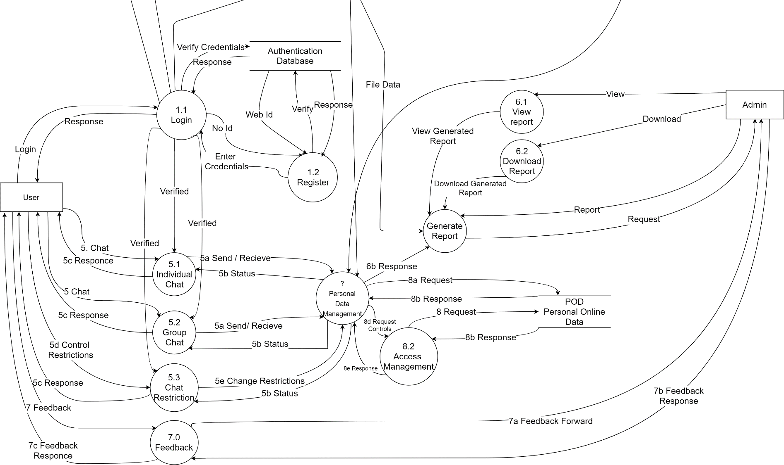
DFD Level 2

Slide 31
Traceability

Slide 32
Traceability
Feature | Functional Requirement
 | FR001 | FR002 | FR003 | FR004 | FR005 | FR006 | FR007 | FR008 | FR009 | FR010 | FR011 | FR012 | FR013 | FR014 | FR015 | FR016 | FR017 | FR018
F001 | ✔ | ✔
F002 |  |  | ✔ | ✔ | ✔
F003 |  |  |  |  |  | ✔ | ✔ | ✔
F004 |  |  |  |  |  |  |  |  | ✔ | ✔
F005 |  |  |  |  |  |  |  |  |  |  | ✔ | ✔
F006 |  |  |  |  |  |  |  |  |  |  |  |  | ✔ | ✔ | ✔
F007 |  |  |  |  |  |  |  |  |  |  |  |  |  |  |  | ✔
F008 |  |  |  |  |  |  |  |  |  |  |  |  |  |  |  |  | ✔ | ✔

Slide 33
Stake Holders

Slide 34
Stakeholders
Internal Stakeholders/Clients
Developing Team
Project Coordinator
External Stakeholders
  End User

Slide 35
Prototype

Slide 36
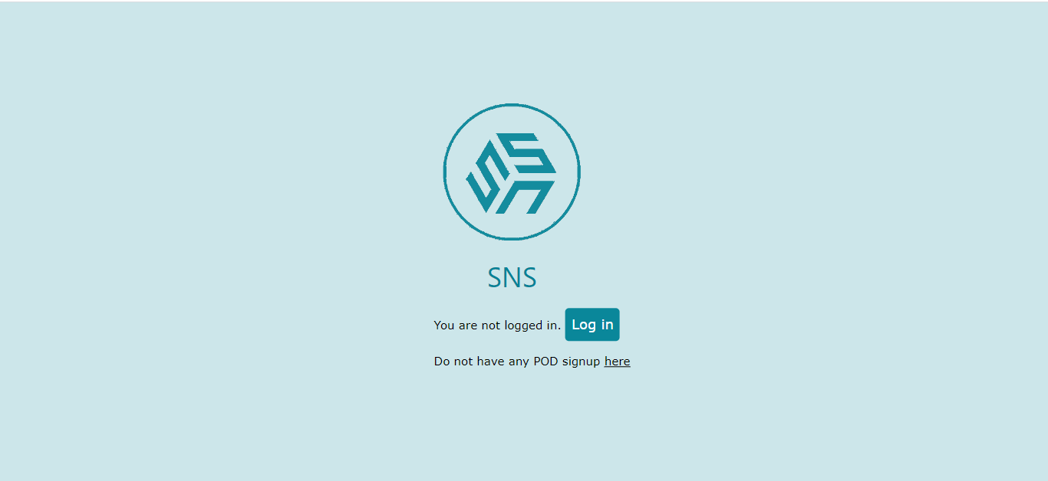
PROTOTYPE
Home Page

Slide 37
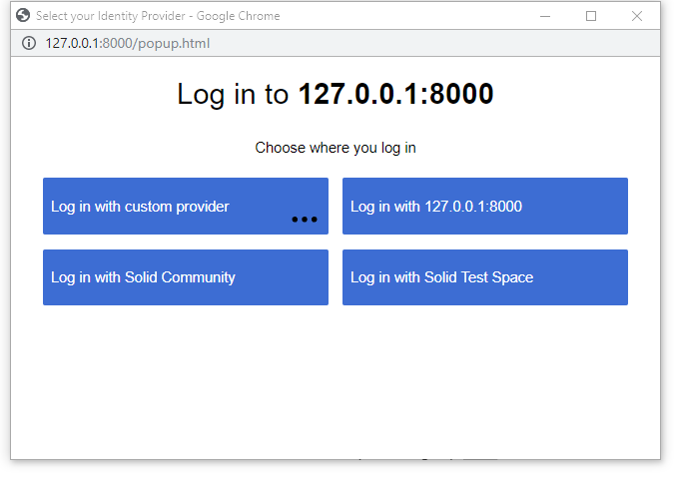
PROTOTYPE
Login

Slide 38
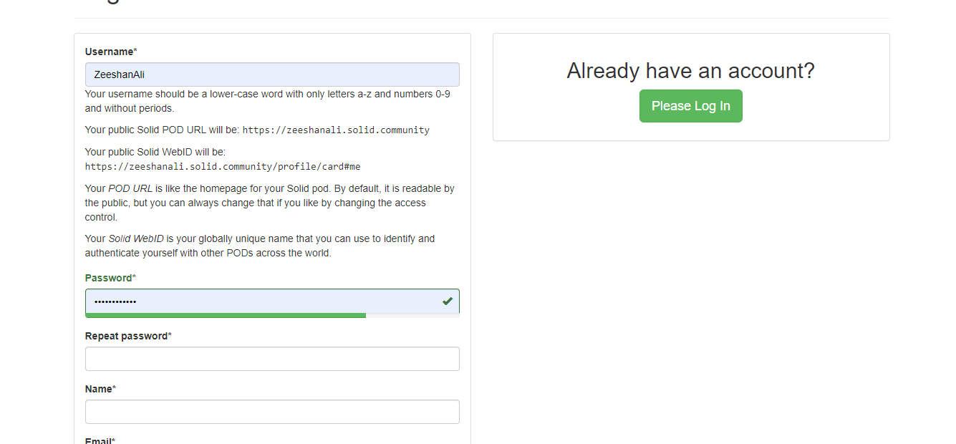
PROTOTYPE
Signup

Slide 39
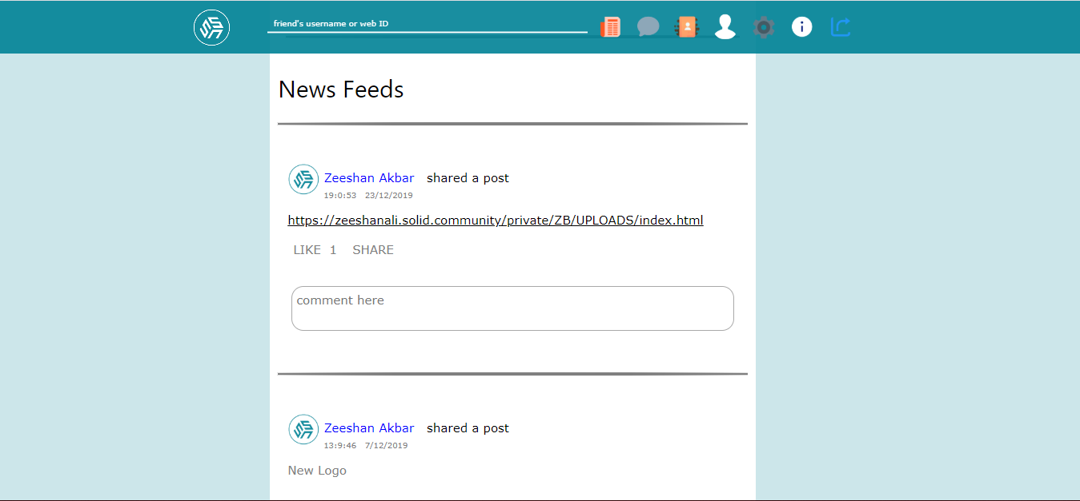
PROTOTYPE
News Feed

Slide 40
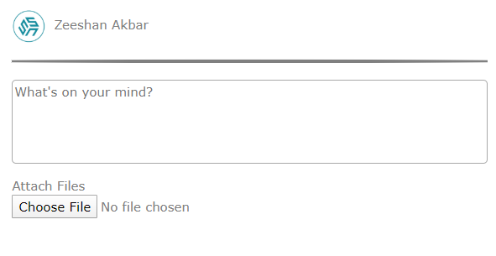

PROTOTYPE
Post

Slide 41
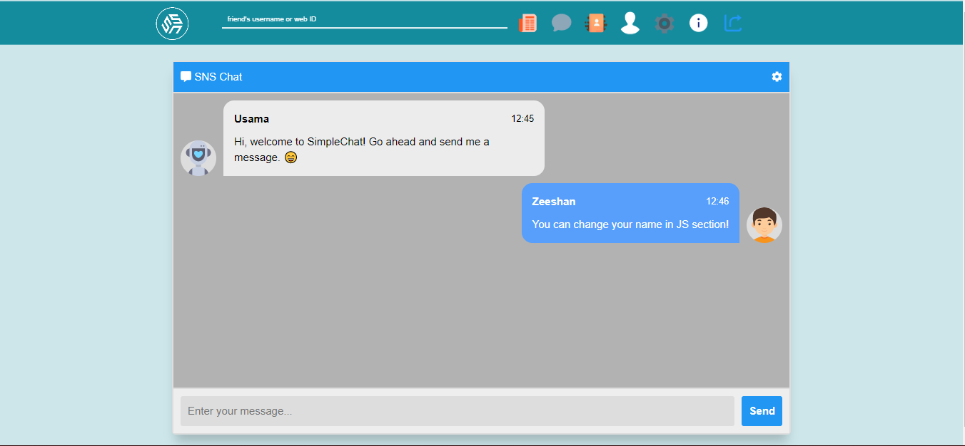
PROTOTYPE
Chat

Slide 42
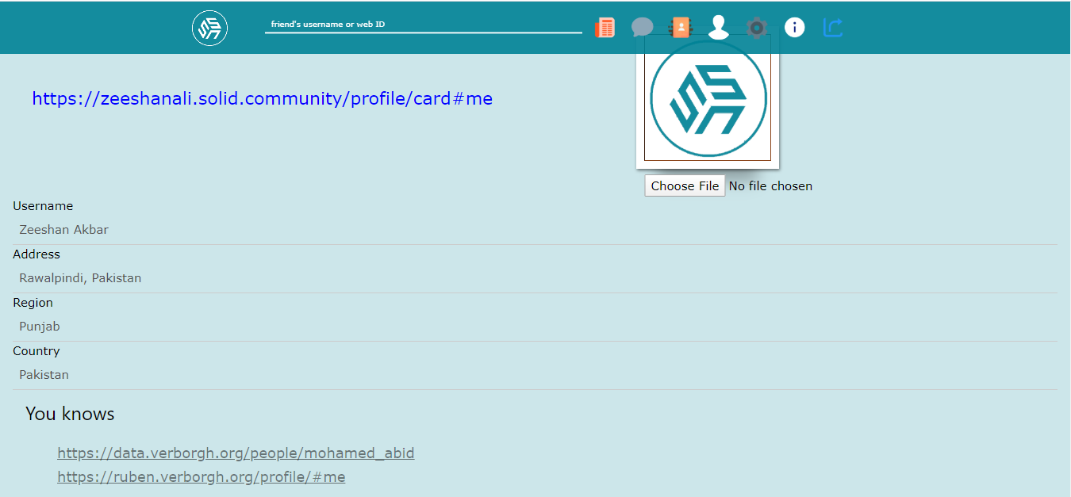
PROTOTYPE
Profile

Slide 43
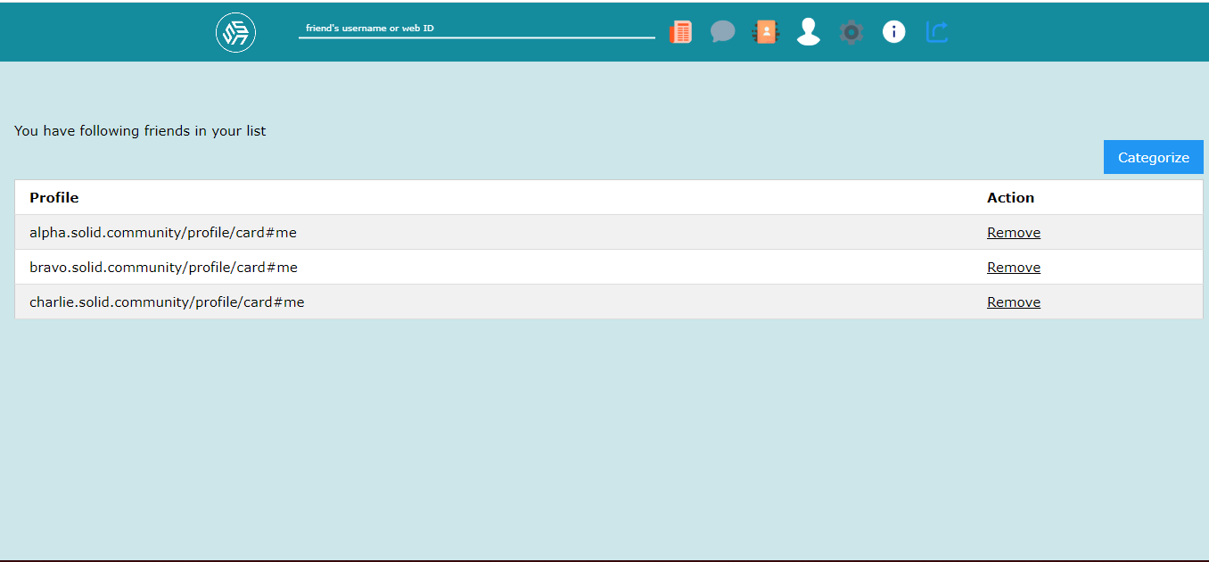
PROTOTYPE
Friend List

Slide 44
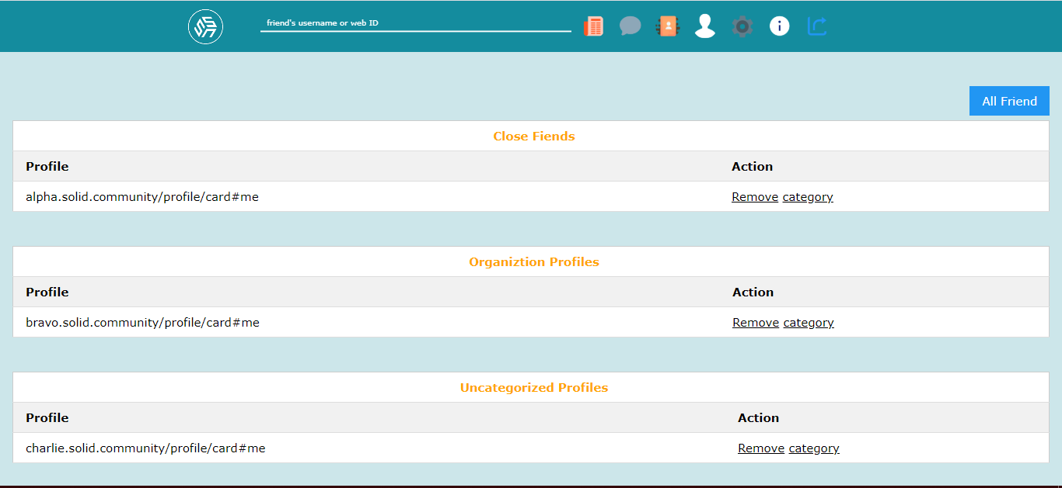
PROTOTYPE
Friend List (Categories)

Slide 45
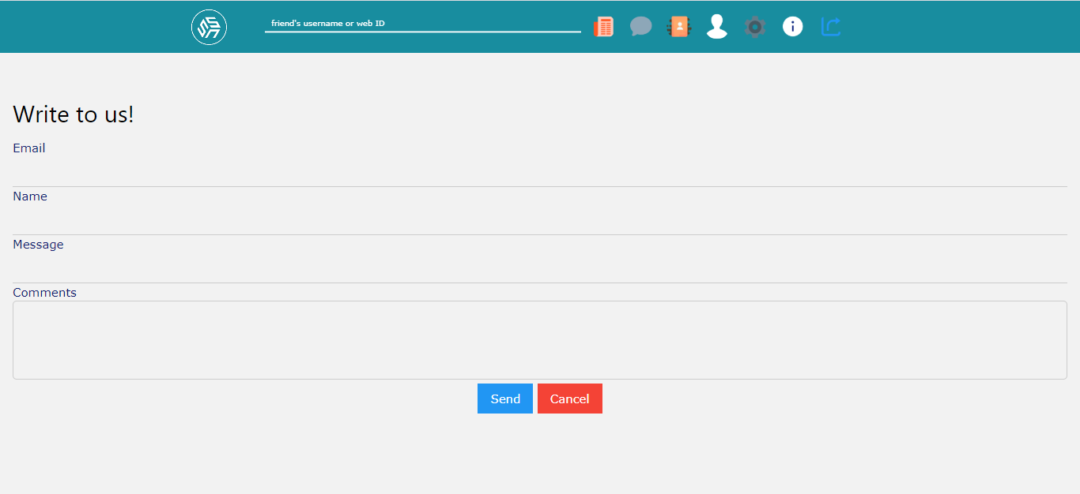
PROTOTYPE
Feedback

Slide 46
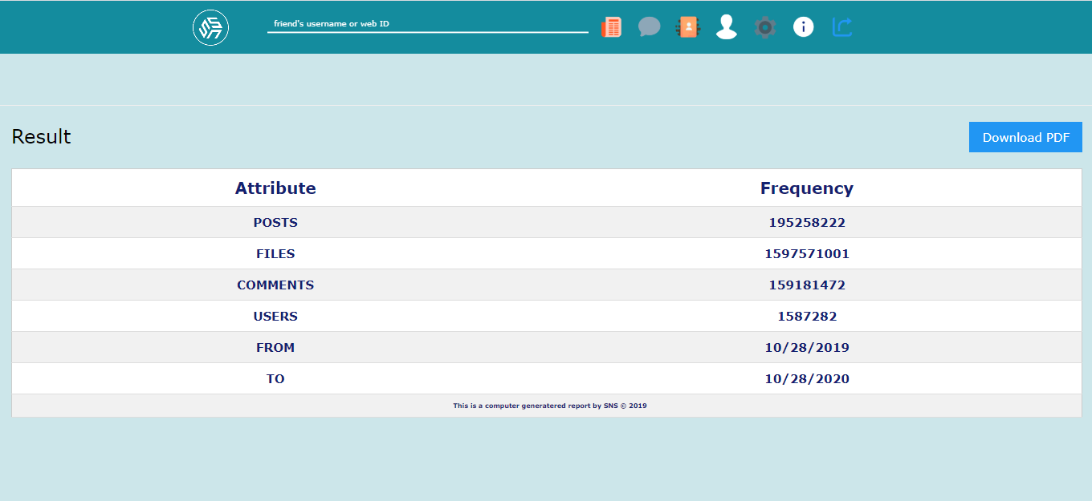
PROTOTYPE
Statistics

Slide 47
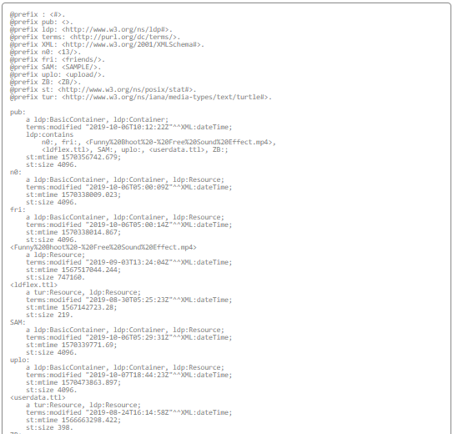
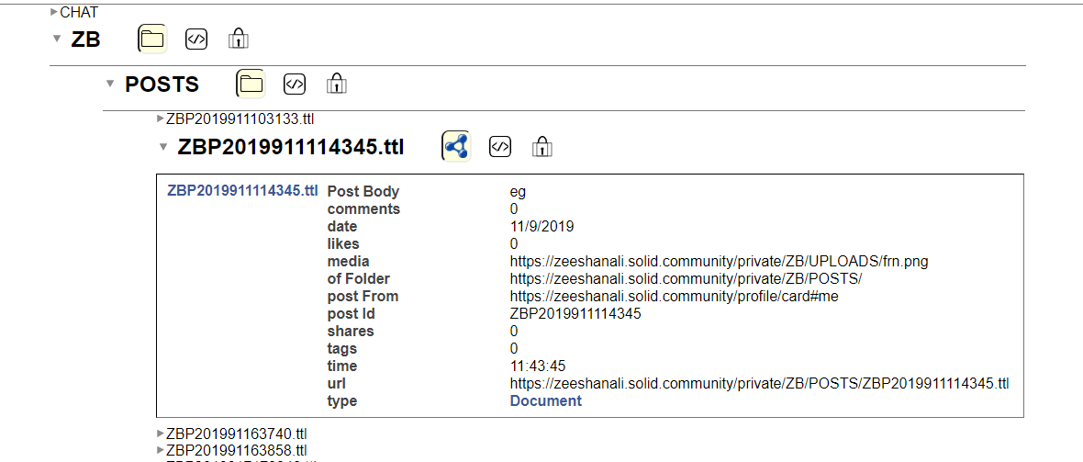
Prototype
SOLID POD’s Structure

Slide 48
SNS
Social Network using SOLID
THANK YOU

